Slide 1
LIBRARY USER GUIDE
ON
ACCESS TO KEFRI INSTITUTIONAL REPOSITORY
By KefriLibrary@2021
Email: library@kefri.org

Slide 2
STEP 1:
From the library portal, click on “KEFRI Repository” menu Item at the top

Slide 3
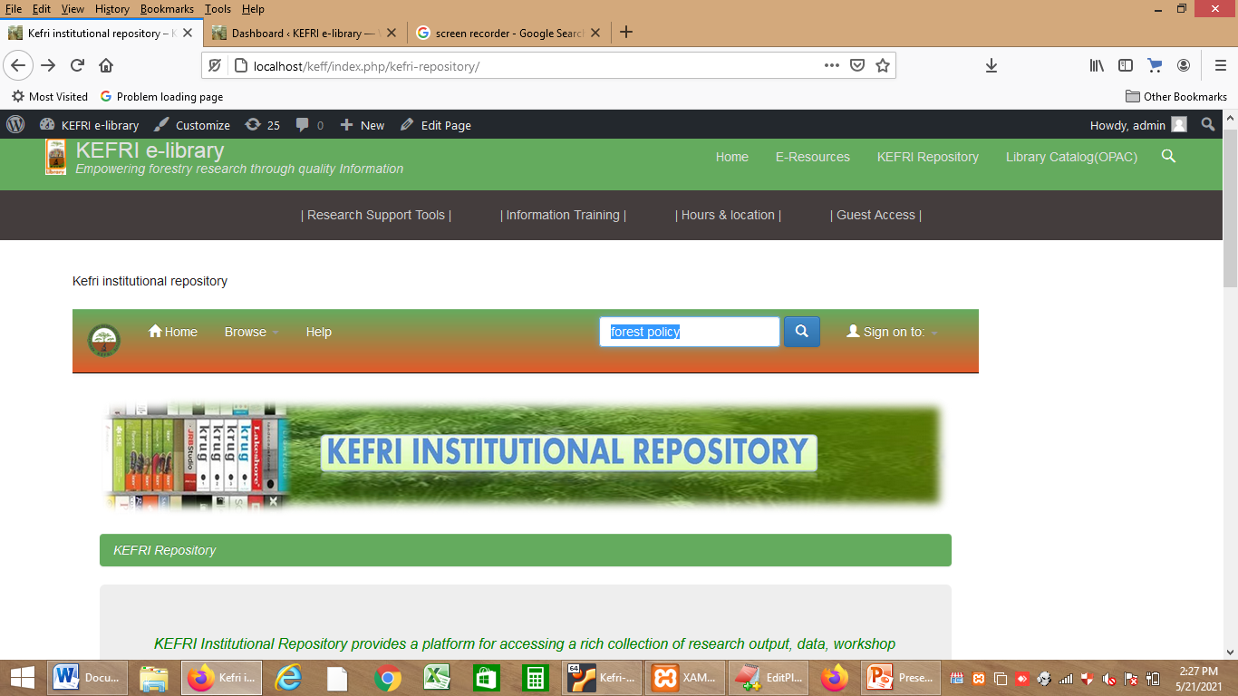
STEP 2:
Search by typing search term on the Search box located on the top right and press ENTER or click on the blue Search icon. e.g. “forest policy”
NB: Search can also be done by using advanced search tool, browsing /discover by author ,subject, Date or Select a community/Collection and search within it.

Slide 4
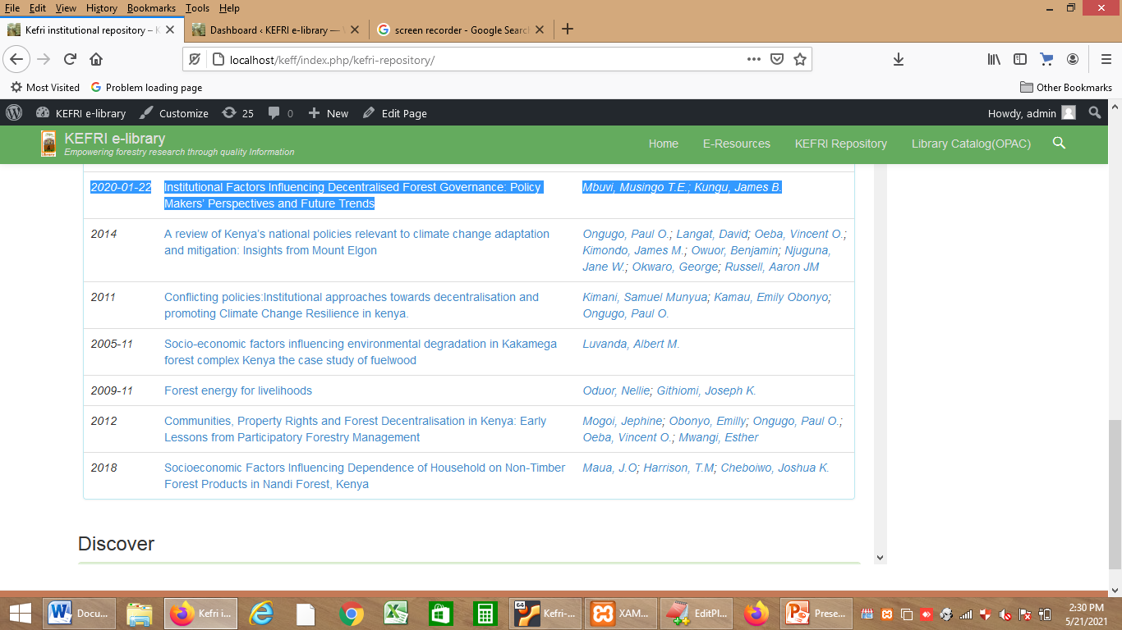
STEP 3:
From the results, identify the relevant item(s) and click on it to open link

Slide 5
STEP 4:
Click on the File or “View/Open” option to download the file

Slide 6
INFORMATION IS POWER
For queries email: libray@kefri.org

